Slide 1
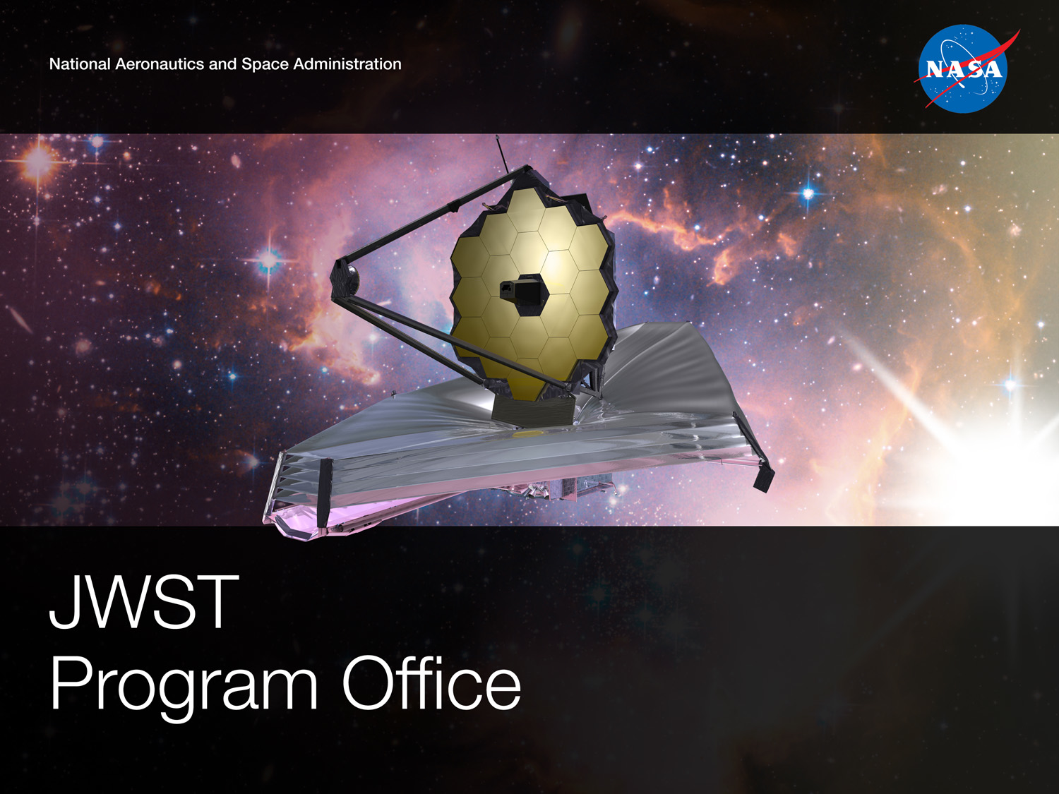
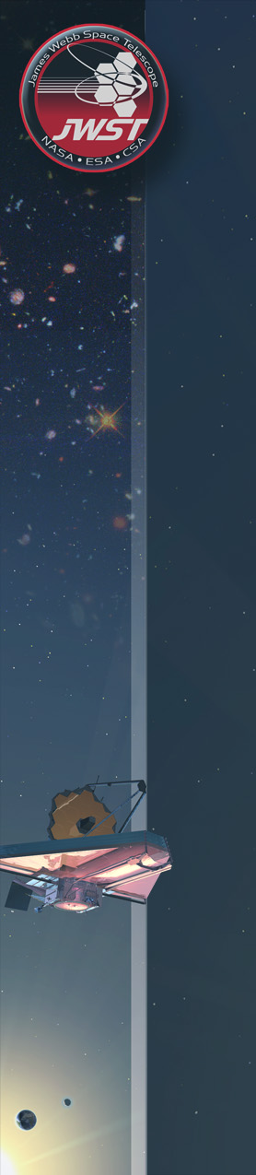


Status of the
James Webb Space Telescope (JWST)
Optical Telescope Element (OTE)
Northrop Grumman: Charlie Atkinson, Scott C. Texter
NASA/GSFC: Lee Feinberg, Ritva Keski-Kuha
July 6th, 2012

Slide 2
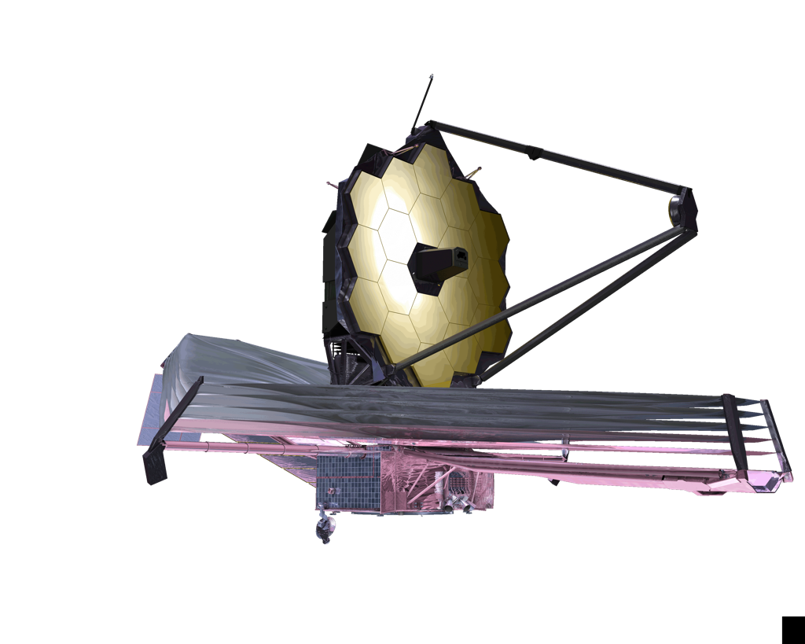

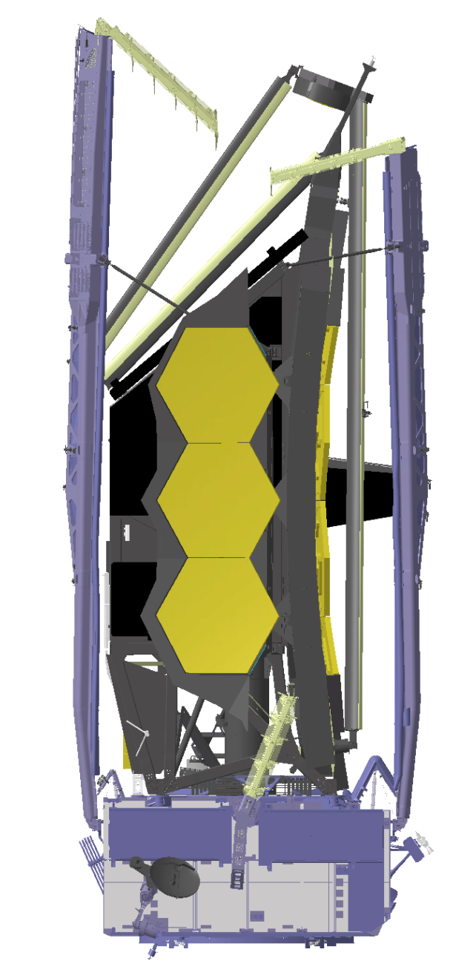
JWST Observatory Breakdown
Optical Telescope Element (OTE)
Integrated Science Instrument Module (ISIM)
GSFC
Sunshield
Spacecraft Bus
2

Slide 3
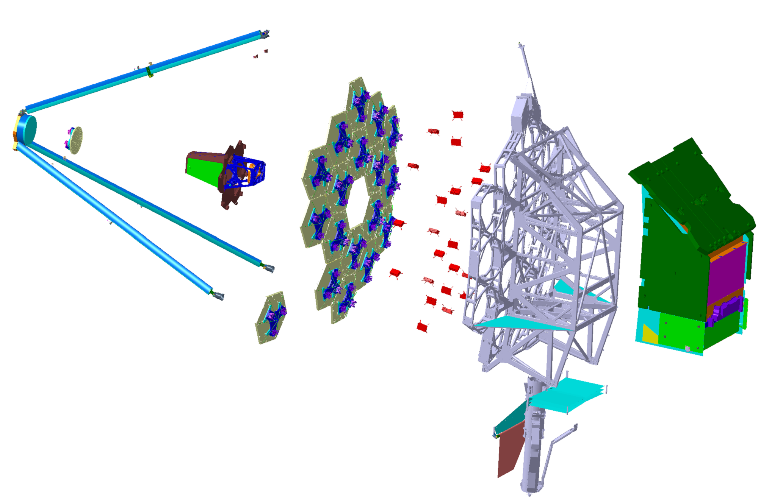

OTE Architecture Overview
Secondary Mirror Support
Structure (SMSS)
Aft Optics
Subsystem (AOS)
OTE Electronics
Cold Junction Box
Cryo Multiplexer Units
Thermal Management Subsystem (TMS)
ISIM Roof Radiators
ISIM Enclosure (MLI)
Parasitic Tray Radiator
Secondary Mirror
Assembly (SMA)
Primary Mirror Segment
Assemblies (PMSA)
Primary Mirror Backplane Assembly (PMBA)
PM Backplane Support Structure (PMBSS)
PM Backplane Mechanism
Deployment Tower
Assembly (DTA)
Thermal Management
Subsystem (TMS)
Astro
Deployable “Batwings”
Fixed Diagonal Shield
Deployable Stray-Light “Bib”
3
Notes:
3

Slide 4
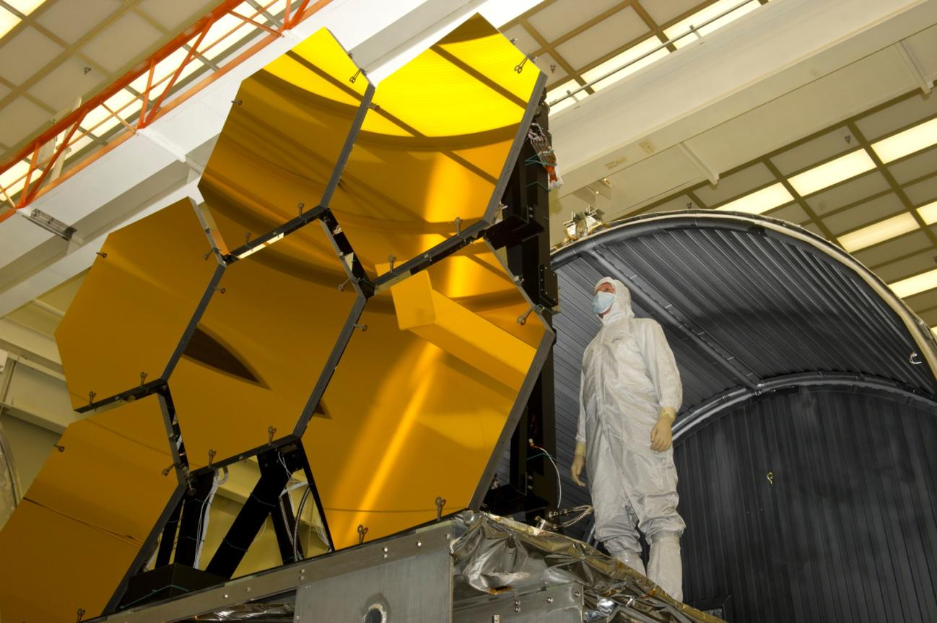
All 18 PMSAs are complete!!!
4

Slide 5
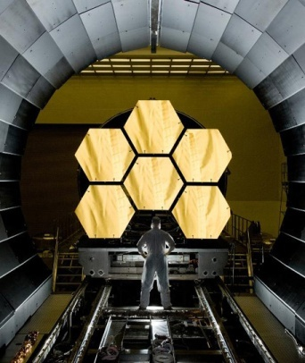
Measured Primary Mirror Cryogenic
Surface Figure Error meets requirements
6 PMSAs ready for cryo testing
Composite Primary Mirror meets requirements
5

Slide 6
PMSA process durations improved with each production batch
Final batch CCOS iterations < ½ EDU iterations
So, the final batch completed months ahead of schedule.
EDU
Flight mirrors
Excellent convergence rate on flight mirrors
6

Slide 7
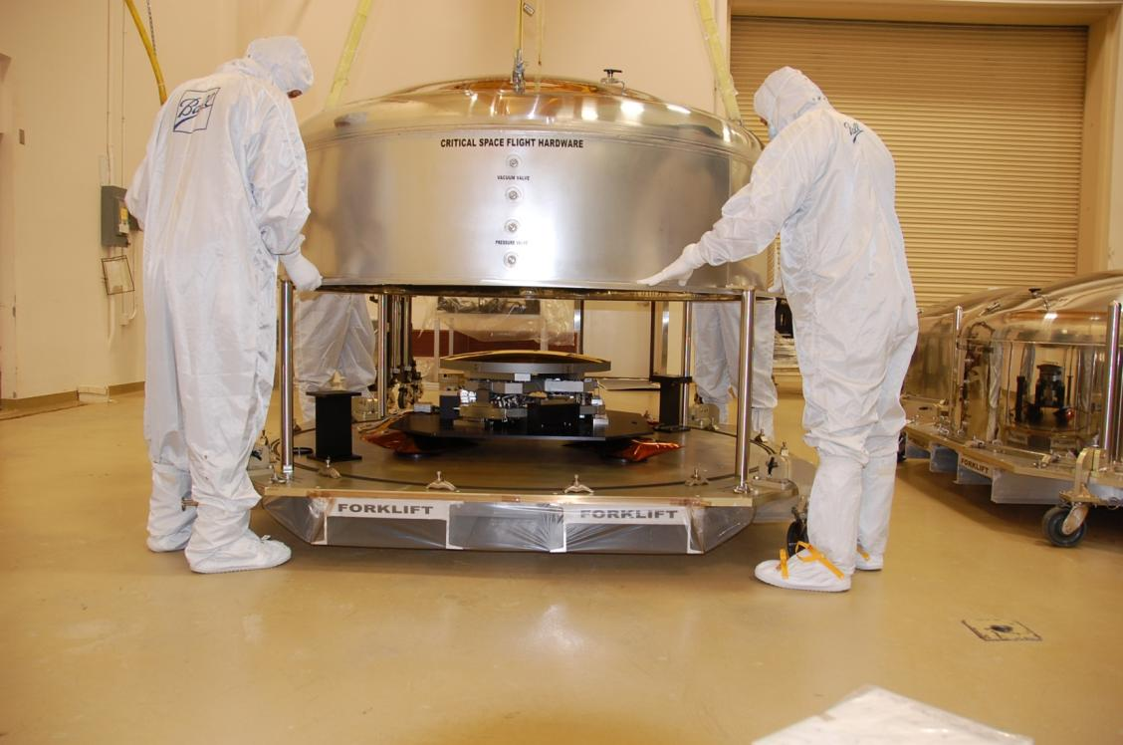
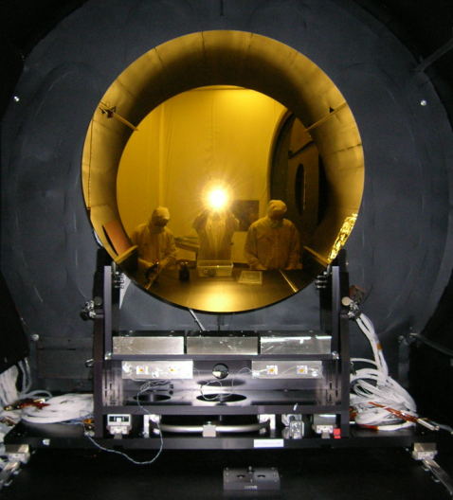
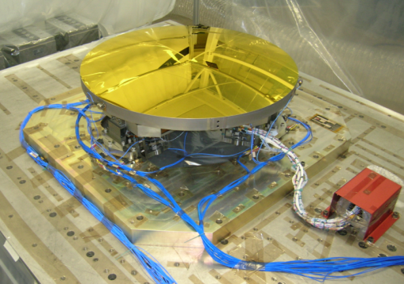
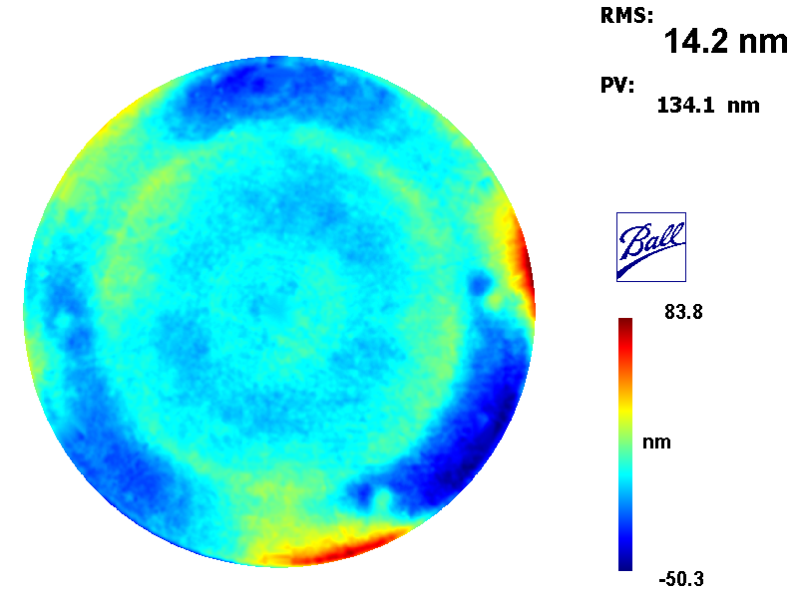
Flight SMA is Complete
SMA SFE: 19.8nm RMS SFE (including measurement uncertainty) vs. 23.5nm req’t
On convex mirror 0.7 meters in diameter.
One of the more challenging tasks on the program, and therefore, one of the more spectacular achievements.
20K SMA Measured Surface Figure
14.7nm
7

Slide 8
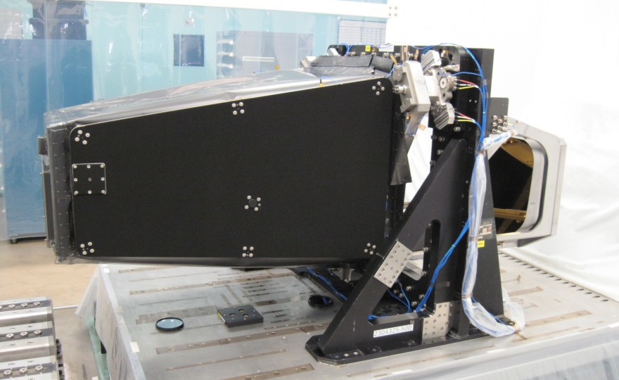
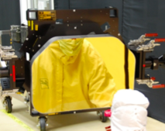
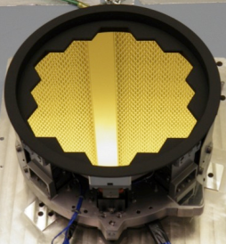
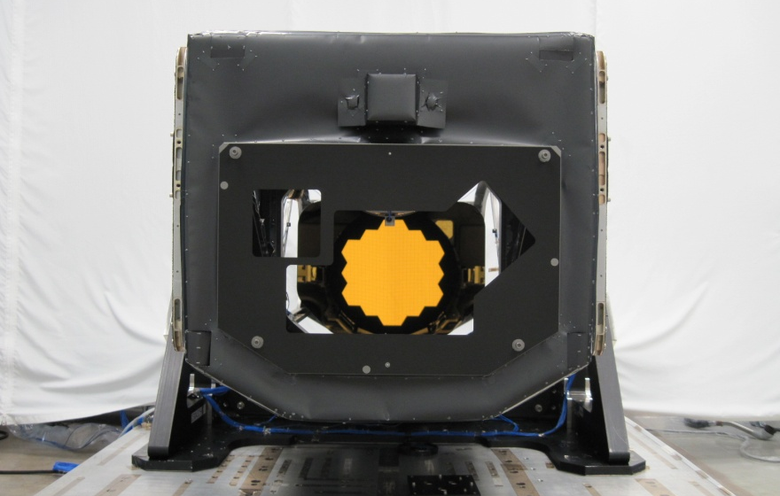
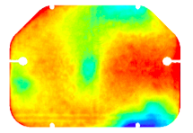
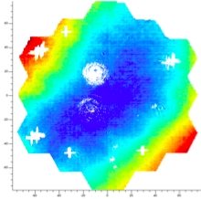
The fully integrated AOS is in final test
Mirror | Measured (RMS SFE) | Uncertainty (RMS SFE) | Total (RMS SFE) | Require-ment (RMS SFE)
Tertiary | 18.1 nm | 9.5 nm | 20.5 nm | 23.2 nm
Fine Steering | 13.9 nm | 4.9 nm | 14.7 nm | 18.7 nm
Fine Steering Mirror
Tertiary Mirror
8

Slide 9
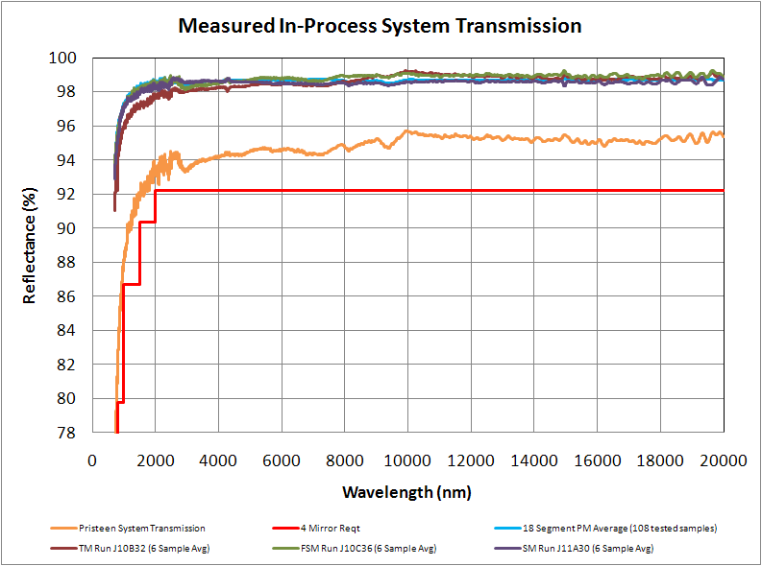
System transmission meets requirements
9

Slide 10
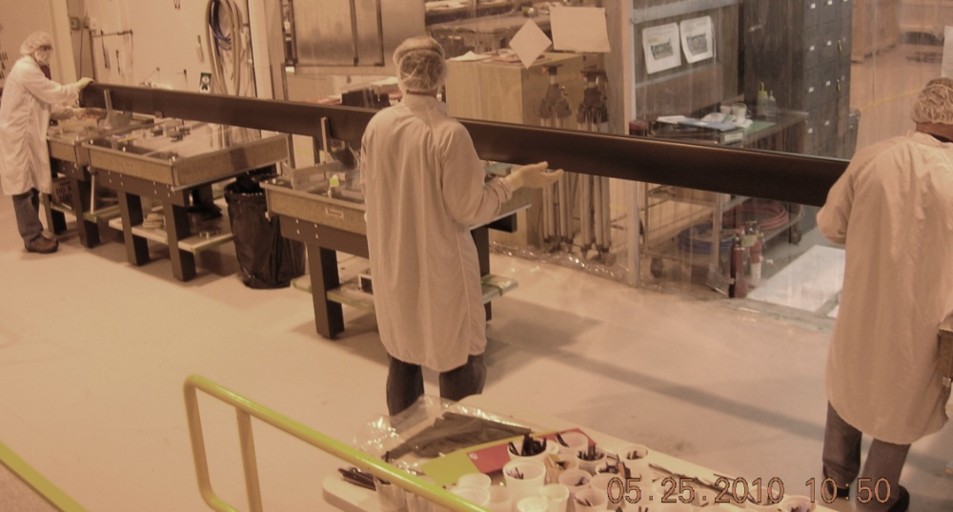
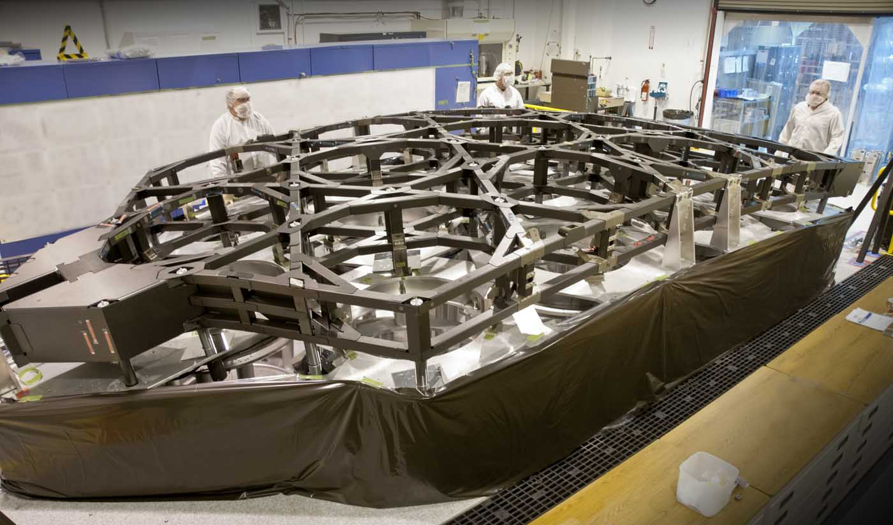
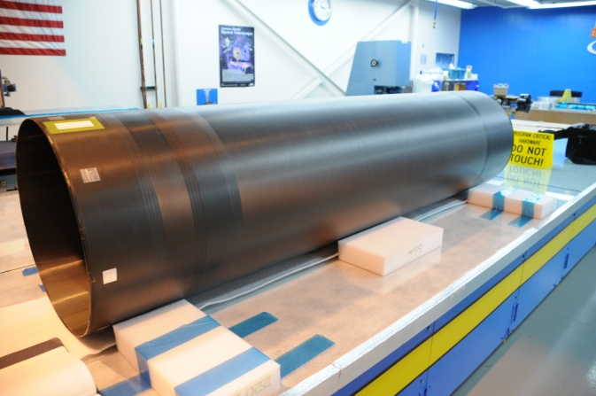
OTE Structure Status
All four SMSS tubes have been manufactured
The PMBSS Center Section is complete
The Backplane Support Frame (BSF) is in assembly
DTA tubes have been produced and machined
DTA deployment mechanism qualification testing has started
SMSS and PMBA wing deployment mechanisms starting their qualification testing
BSF
Center Section
10

Slide 11
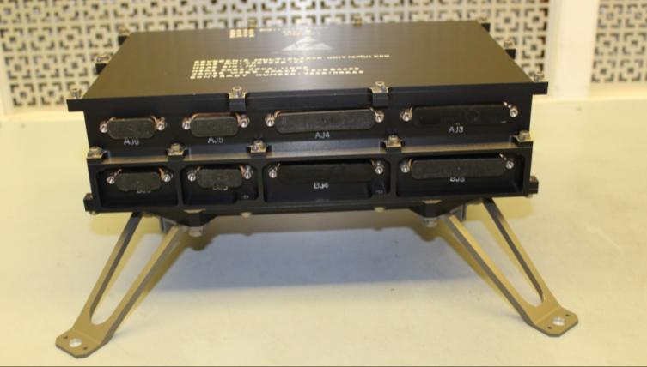
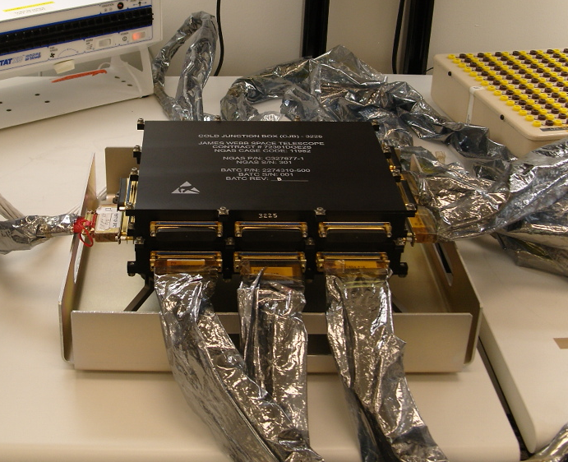
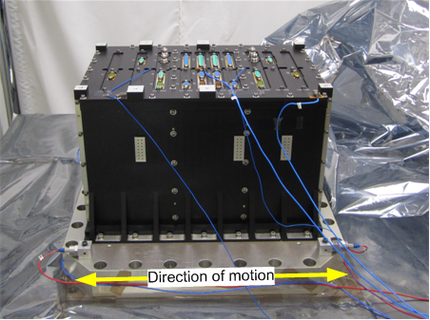
OTE Electronics are progressing well
All 22 CMUs have been assembled and have started testing
  2 have completed acceptance testing
  All but three have completed cryogenic testing; will complete in July.
The CJB has been assembled and has completed its acceptance testing.
The EM ADU has been delivered and the flight ADU is in board-level testing.
CMU
CJB
EM ADU
11

Slide 12
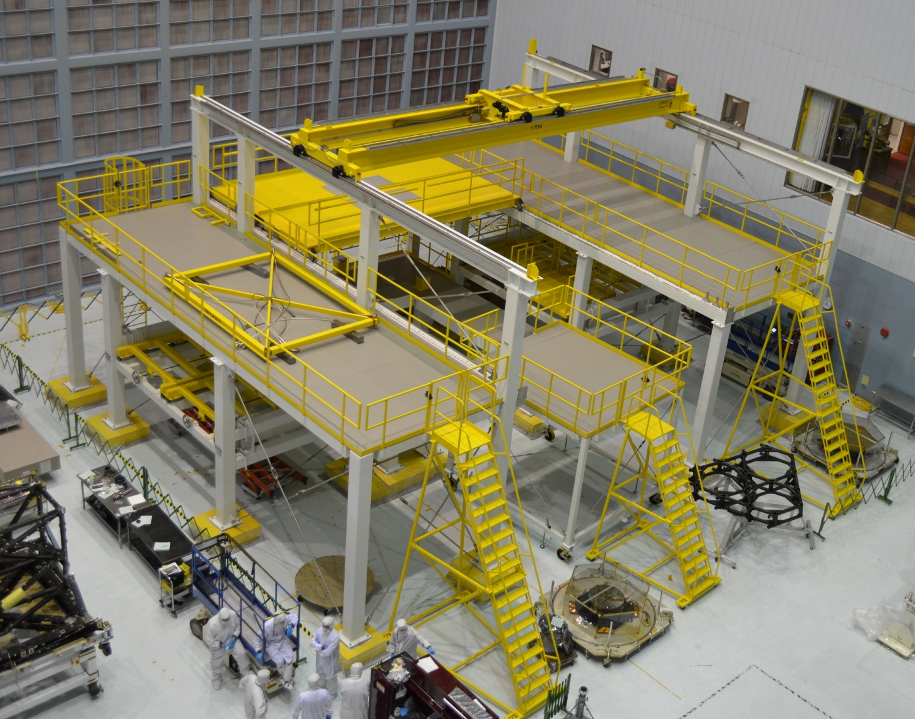
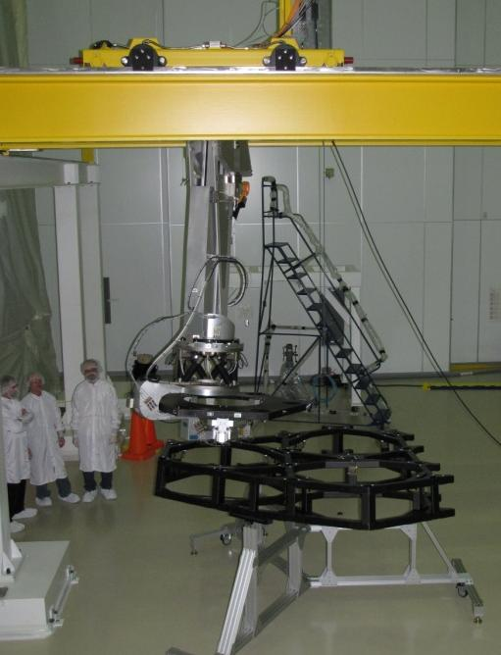
OTE Integration and Test Preparation
The Ambient Optical Assembly Stand is currently installed at GSFC, ready for optics integration
The multi-axis robotic arm used to align and install the PMSAs onto the OTE structure has been demonstrated

Slide 13
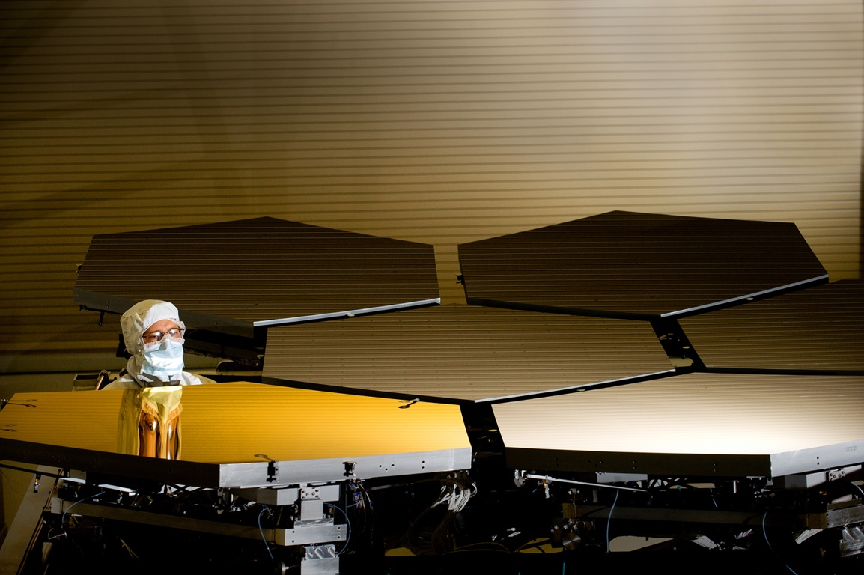
Summary:
  The OTE continues to make terrific forward progress
Acknowledgements
  A very large team of very talented individuals
  From dozens of organizations across 11 (or more) states

